Slide 1
How to Analyze Data in R
Class Project PSYC 300B

Slide 2
Why R?
I’ll be posting instructions on how to use SPSS for the class projects so why don’t we just use that?
Well, R is free! And not only that, it is open source which means that if there are any problems with packages then fixes can be implemented quickly
With SPSS you would have to wait for a new release…in the past there have statistical tests that have been computed wrong for years
You can download R + R Studio on your computers at home

Slide 3
Note
The Red boxes (see below) are simply there to draw attention to things you should see or for things you need to interpret/click on

Slide 4
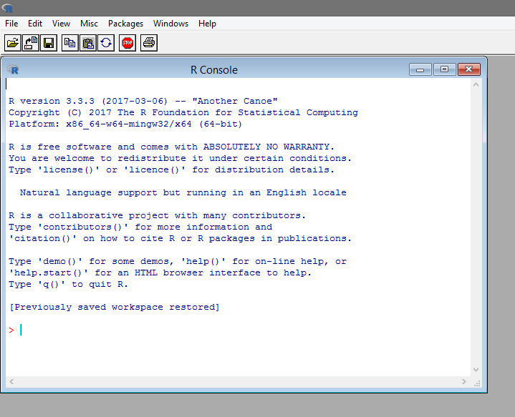
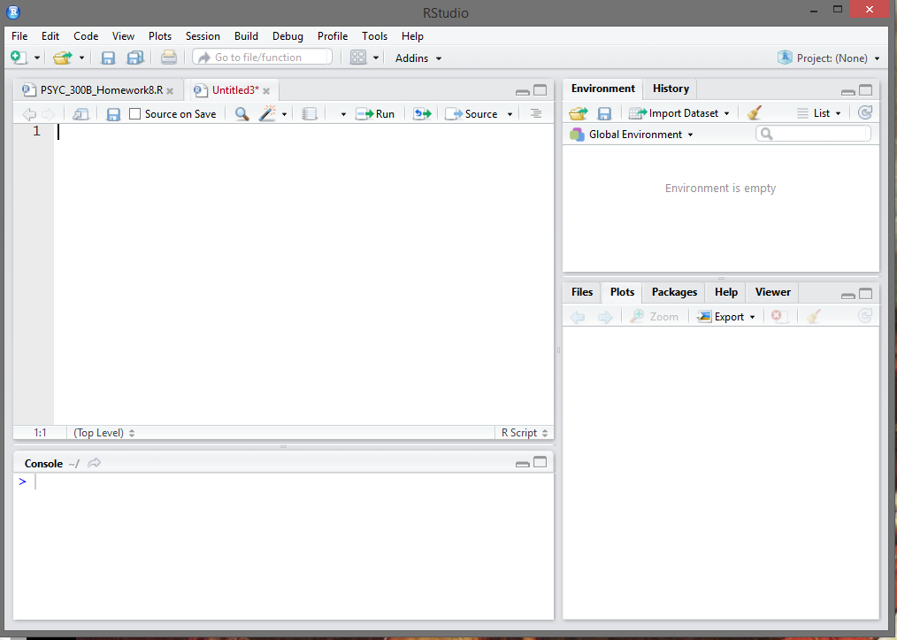
R & R Studio
R is the program you’ll be using (on the left)
R studio is simply a GUI/interface for R that makes your life (a lot) easier (on the right)
R
R Studio

Slide 5
How to Download R & R Studio
Once you have downloaded and opened R once, you will never need to open it again. You can always just work through R studio (which I would heavily advise!)
There are two steps to get this working
Download R
Download R Studio
Simple right?

Slide 6
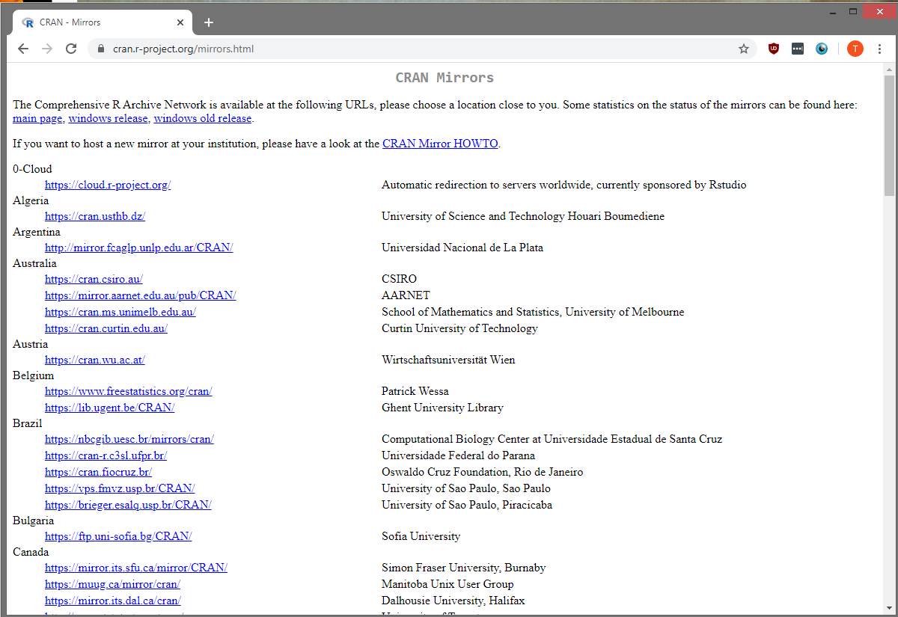
How to Download R
First you’ll need to visit the R website (https://cran.r-project.org/mirrors.html)
Then navigate down to Canada (it doesn’t really matter) and download from any University (SFU is highlighted here)
Just click on that link!
Or you can just visit to get it directly: https://mirror.its.sfu.ca/mirror/CRAN/

Slide 7
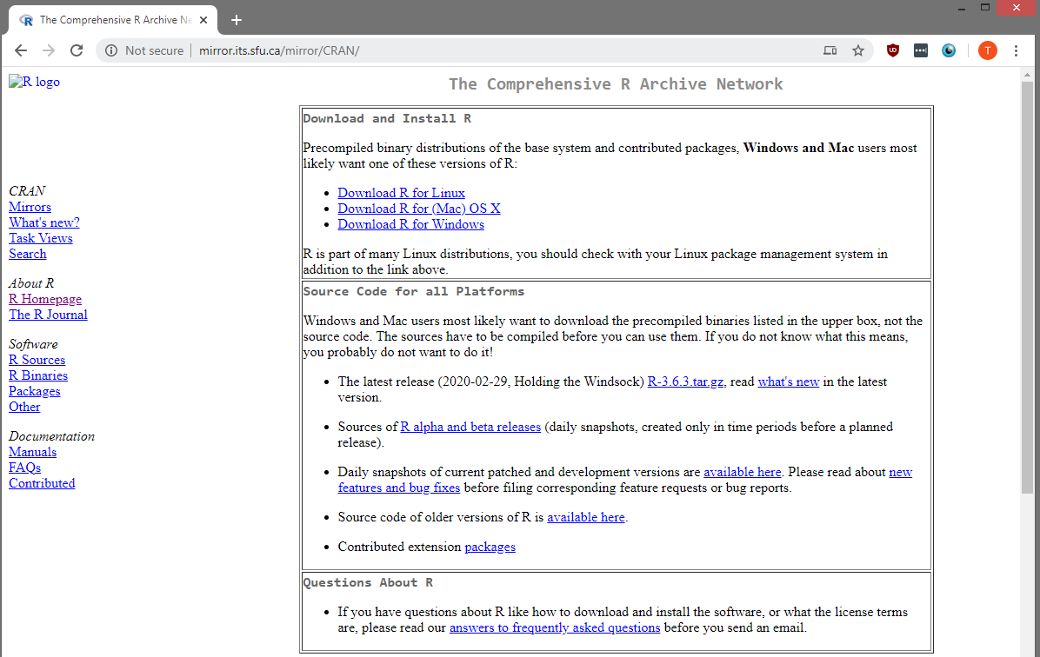
How to Download R
Then you just need to download the R most appropriate for your computer

Slide 8
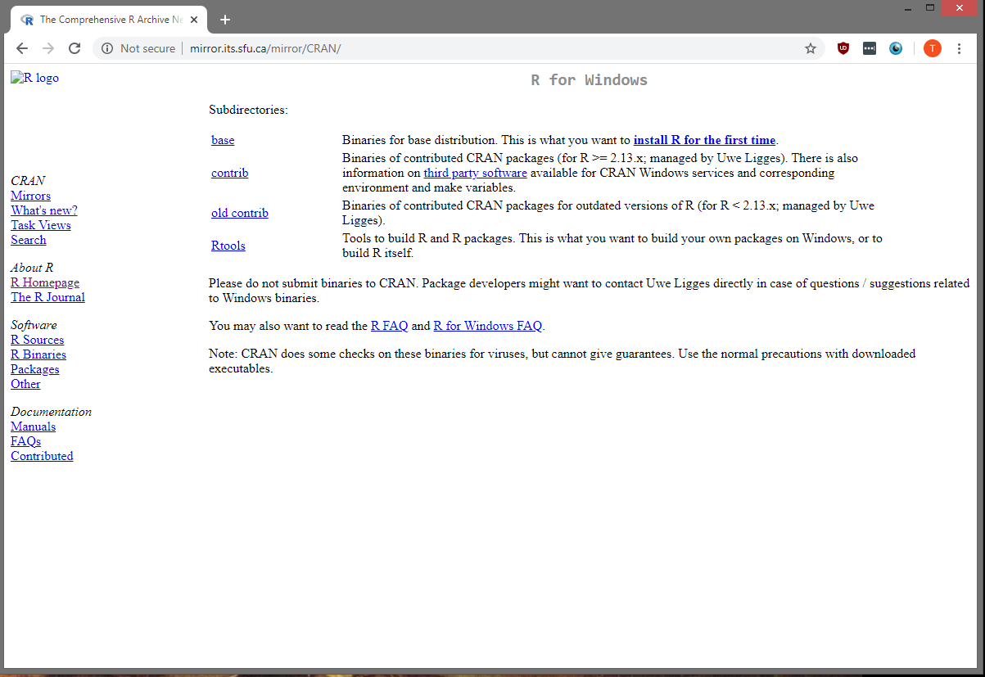
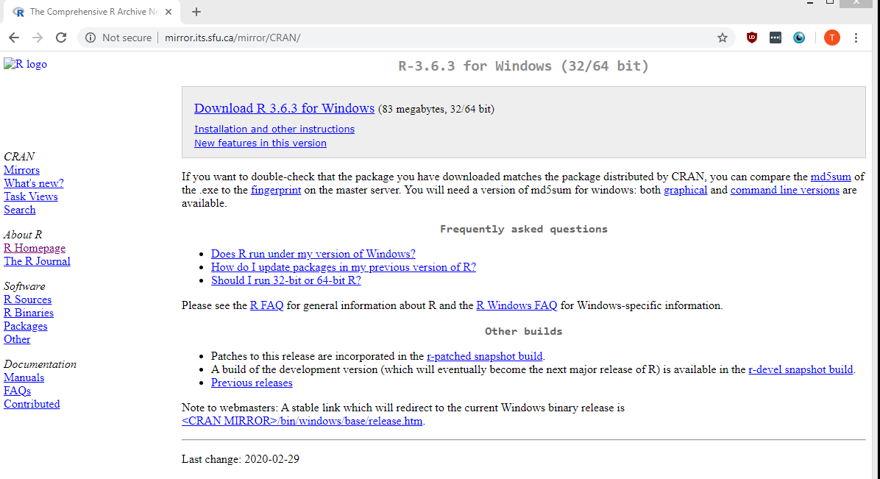
How to Download R
Then after you’ve selected either Mac/Windows/Linux, you just need to select “Base” – in this case I’ve chosen Windows as my option
Then just hit download. You should see the program downloaded now.

Slide 9
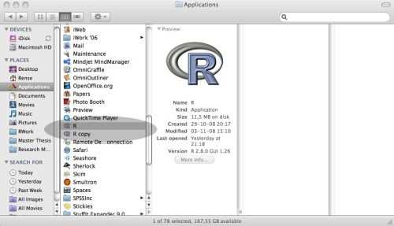
How To Download R
For Mac Users you’ll want to copy the program to your applications folder (see below)
For windows users, you can really choose where you want to download it
Last thing is that you need to run the program (just double click on it)

Slide 10
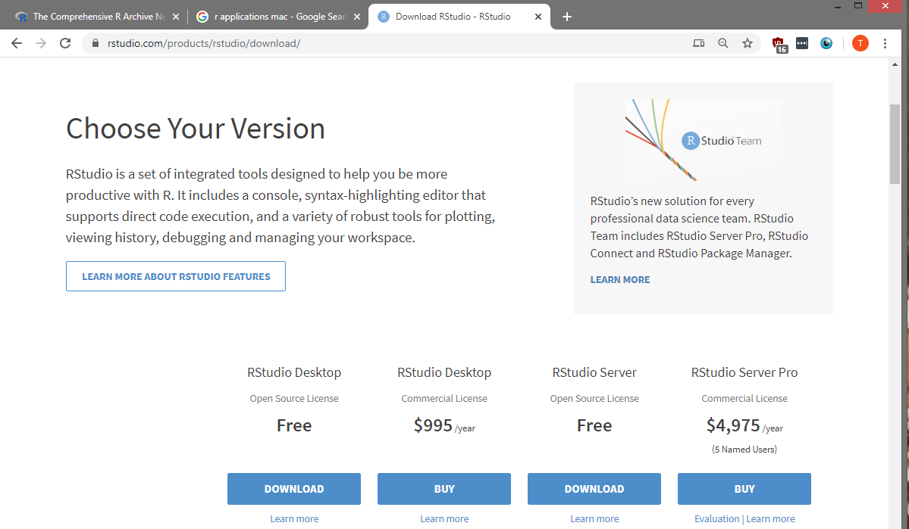
How to Download R Studio
To download R studio, you’ll want to visit:
https://rstudio.com/products/rstudio/download/
Then Navigate down the page until you find the download button

Slide 11
How to Download R Studio
NOTE: You want the free version! It has everything we need (the others ones are for commercial purposes so we can ignore them)

Slide 12
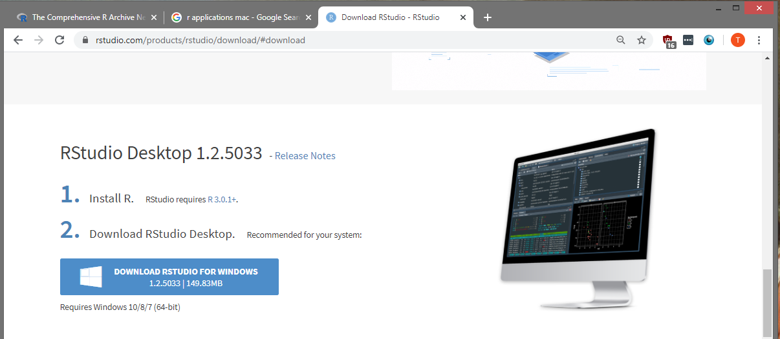
How to Download R Studio
Then just hit download again (this should be Mac for Mac users and Windows for – in my case – a windows machine)

Slide 13
How to Download R Studio
The program should download and then you can just run it!
For Mac users, you’ll want to copy R studio to your applications folder (like we did with R)
For windows users, you can really put R studio anywhere you want

Slide 14
Getting Things Going
Well now that you’ve downloaded it…just run R studio!
We literally never need to run R after this – only run R Studio

Slide 15
Intro to R Studio Environment
Environment: this is where you can see what variables and data are loaded
Current Script: This is where you would actually code - Currently it is blank!
Accessories: this is where plots will pop up, you can verify your packages are installed, etc.
Console: This is where you would run your code – when you run a line this is where output is. You can also type stuff here

Slide 16
Scripts
I will give you a script for analysis – it is posted on the course spaces
Essentially, all you’ll need to do is interpret the output of your script
Typically however, whenever you are working in R studio you create scripts and that is where you primarily work
Always make sure to save your work!
I have shown you most of the functions you’ll need to run in-class (ANOVA, Levene)

Slide 17
Scripts
If you use Windows – use the windows script
If you use Mac – use the mac script
There are very small differences between them

Slide 18
Introduction to our Script
I will give you a script for analysis – it is posted on the course spaces
In the following slides are the script itself. I have tried to annotate it. However, the following slides lay it out in more detail
On most slides the image on the left is the script while the image on the right is the console. Once you run the commands in the script you should get the output in the console. You should see the output on the right. If you do not, then something is wrong!
The console output is what you’ll need for your paper!

Slide 19
Running a Script
Anytime you see a line that starts with # that is a comment. It does not get ran by R Studio – it essentially ignores that line. The comments are in green in my case.
These comments are there to give you perspective on what is going on
When you run a command from a script, you should see the output of that command in the “console” (see slide 15). This means it has successfully ran (or if not, it will show you the error)

Slide 20
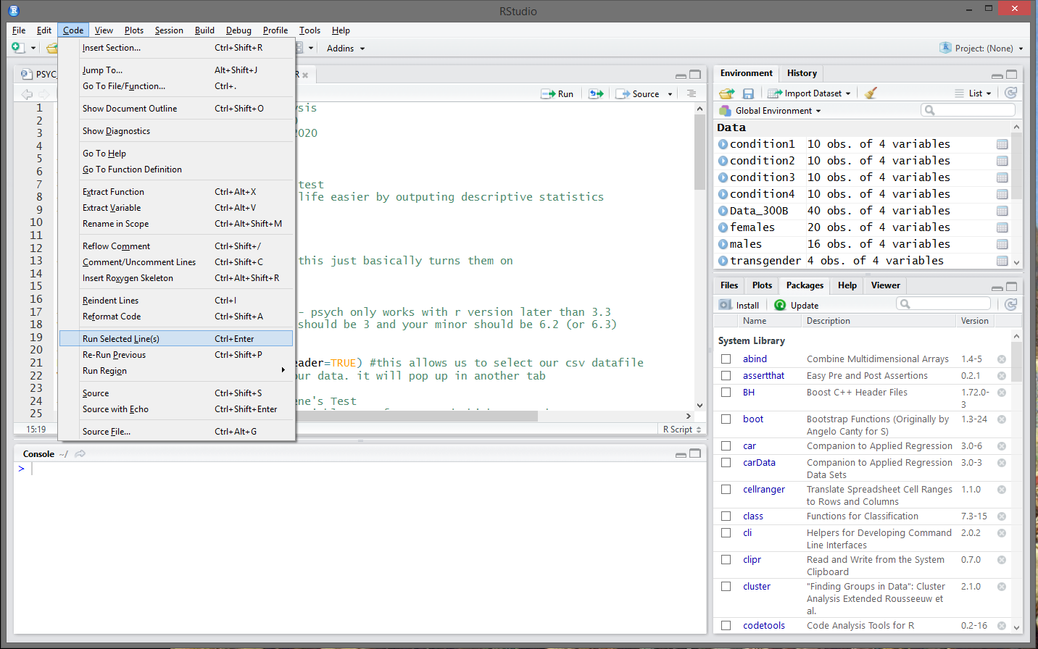

How To Run a Command
How to run a command or an entire script:
To run a command you can either highlight the line and hit “ctrl” + “enter” (windows) or “cmd” + “enter” (mac)
Or you can use the drop down menu at the top (see image below)
You essentially go “Code”→”Run Selected Line(s)”
Or finally, you can just select the line and hit run (this would run the selected line)
Hit that button to run the line
Hit that button to run the line

Slide 21
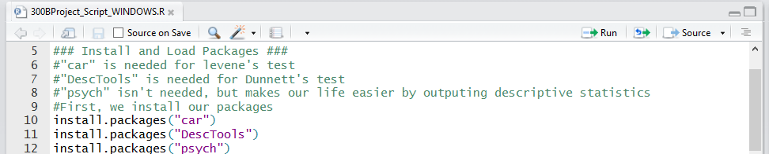
Install Packages
First we will want to install 3 packages (Car, Psyc, DescTools)
We will use “Car” for Levene’s Test, “Psyc” to get descriptive statistics, and “DescTools’ for the Dunnett’s Test
I’m not going to show the output here because it is a lot…but as long as you don’t get any errors when you run lines 10 to 12 you should be fine.
Make sure to accept the restart when it says to restart!
Note: Sometimes the packages ask for input in the console. You just need to type yes there!
Script Input – Run these lines!

Slide 22
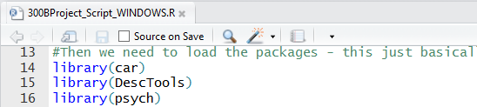
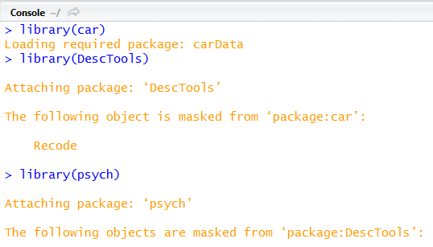
Load Packages
Then we want to load the 3 packages (Car, Psyc, DescTools)
To do this run lines 14 to 16
Your console output should look something like the right
Script Input – Run these lines!
Console Output

Slide 23
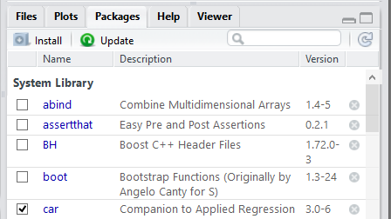

Load Packages
You can check the “Packages” tab (in the accessories section – bottom right) to make sure the packages installed and loaded properly.
In this tab you can also try manually installing them and then loading them if you are having issues. For install you just type the packages and hit enter. Then to load you just check the box

Slide 24

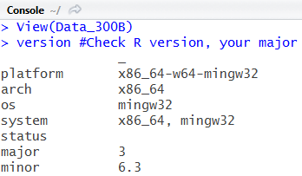
Check your R Version
You will want to be on the most recent release of R
You can check this in R studio using the “version” command (line 18) – if you have any issues with the packages this will be why! Make sure your version is at least 3.6.2 or 3.6.3. The packages we use have issues with earlier versions of R
Check the console after you run the command for major and minor. They need to correspond to 3 and 6.3 (or 6.2)
Script Input – Run these lines!
Console Output

Slide 25
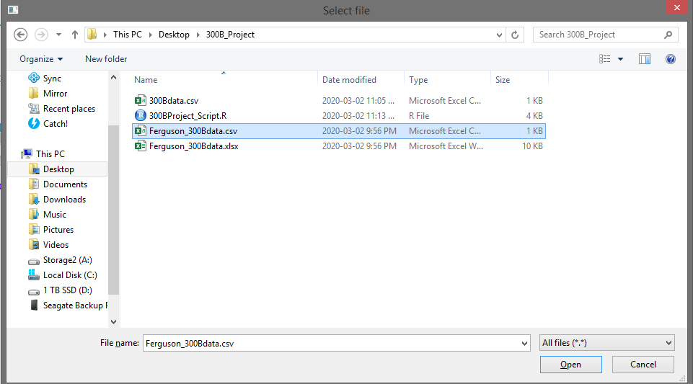

Load Data
Then all we need to do is load the data (line 21).
After you do that you should get the option to select your data pop up. Simply navigate to where you saved your datfile (the .csv file), choose that .csv file and his open!

Slide 26
View Data
You will want to view your data to make sure everything is looking kosher (line 22)
You can do that two ways: either the head command or the view command. Below is an example of the view command
Script Input – Run these lines!
Console Output

Slide 27
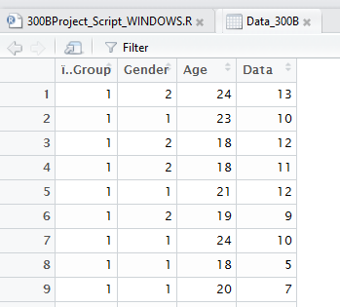
Note on Labels
If you load your data in windows you should see “i..Group” as below (left)
If you load your data in Mac you should see “Group” instead (right)
WINDOWS
MAC

Slide 28
Note on Labels
I RAN THIS ON MY WINDOWS COMPUTER!
SO IF YOU SEE “i..Group” in the code, that is why
Don’t be confused by those label differences

Slide 29
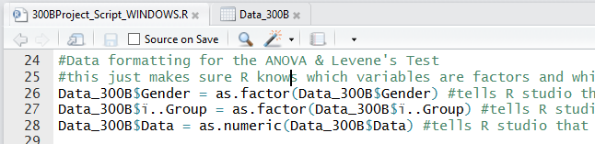
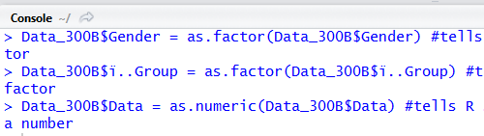
Formatting Data
In order to make sure the ANOVA command works, we need to tell R which columns of our data are factors and which are numbers (i.e., our DV)
Run the below commands (line 26 to 28) to ensure this is the case
Script Input – Run these lines!
Console Output

Slide 30
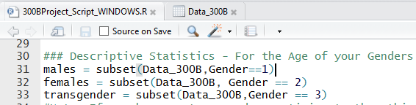
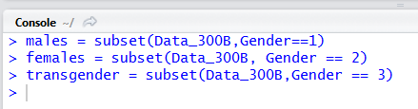
SubSet Data #1
We then need to subset (lines 31 to 33) our data for the age analysis (this is purely for descriptive purposes!)
Script Input – Run these lines!
Console Output

Slide 31
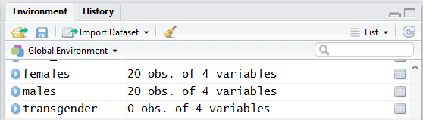
SubSet Data #1
Note: we can check if this worked by looking at the environment tab
We see that we have 20 females and 20 males (the obs mean people in this case)
In this case we have 0 transgender people in our sample
Your numbers might be different! But if you add those numbers up it should be 40

Slide 32
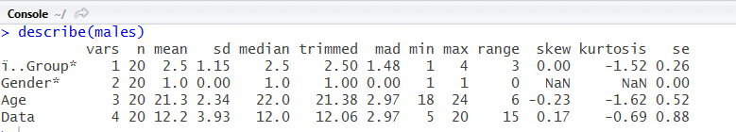
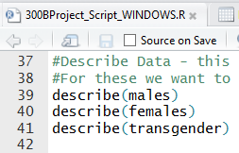
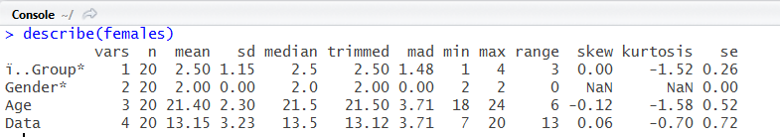
Descriptive Statistics - Age
Run the describe command (lines 39 to 41) to extract descriptive stats (you’ll need the means and SD)
We want to mean and SD for Age (red box)
Console Output
Script Input – Run these lines!

Slide 33
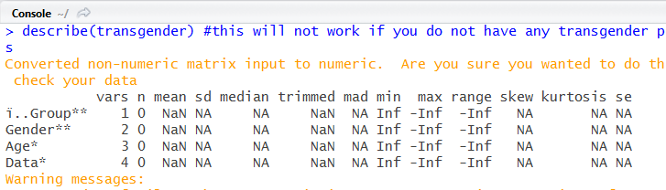
Descriptive Statistics - Age
Note we have no transgender participants in this sample, so our describe command doesn’t work
Script Input – Run these lines!
Console Output

Slide 34
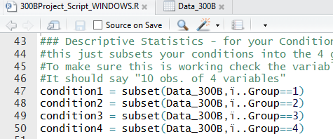
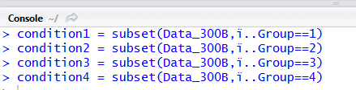
SubSet Data #2
We then need to subset our data (lines 47 to 50) for the conditional analysis (this is purely for descriptive purposes!)
Script Input – Run these lines!
Console Output

Slide 35
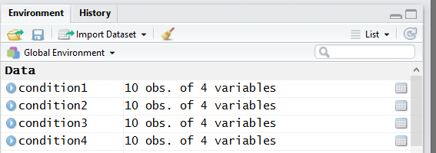
SubSet Data #2
Note: we can check if this worked by looking at the environment tab
We see that we have 10 people in each group (you should have this – it should also sum to 40 if you add up across all groups!).
Remember “obs” means people essentially

Slide 36
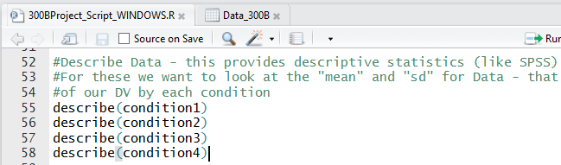
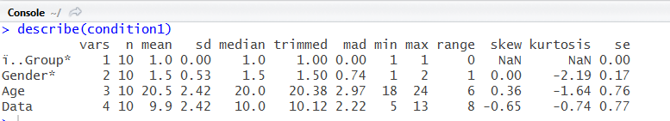
Descriptive Statistics – Conditional Means
Run the describe command (lines 55 to 58) to extract descriptive stats (you’ll need the means and SD)
Below is the output for condition 1 only…(see the red box – rather than age we are looking at the data line)
Script Input – Run these lines!
Console Output

Slide 37
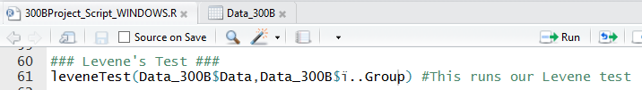
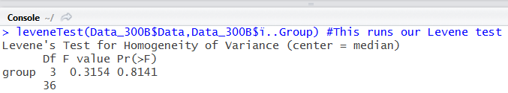
Run Levene’s Test
Then we need to run Levene’s test to test our homogeneity of variance assumption.
To do so run line 61
Output will be sent to console (see right).
Script Input – Run these lines!
Console Output

Slide 38
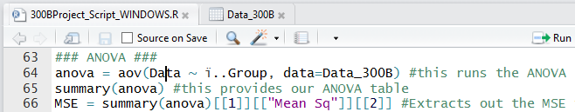
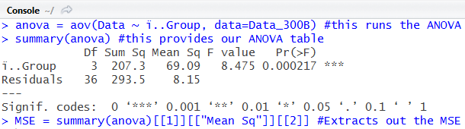
Run the ANOVA
Then we run our ANOVA (line 64) and summary (line 65)
The summary command is what gives us our output – not residuals is just what R calls the error/within subject part of the table
Finally we run the MSE line (line 66) in order to extract our MSE value for the post-hoc test (either Tukey’s or Dunnett’s depending on your design)
Script Input – Run these lines!
Console Output

Slide 39
Post-Hocs
You will need to write out your planned comparisons by hand
However, R can help us run our Post-Hoc tests
You will want to either use Tukey’s Test or Dunnett’s Test – it depends on your design
Not BOTH!!!!!!!!!

Slide 40
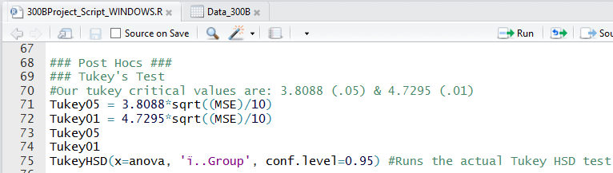
Run Tukey’s Test
Below is the lines we need to run for our Tukey’s test (line 71 to 75)
Output is on the next page
Script Input – Run these lines!

Slide 41
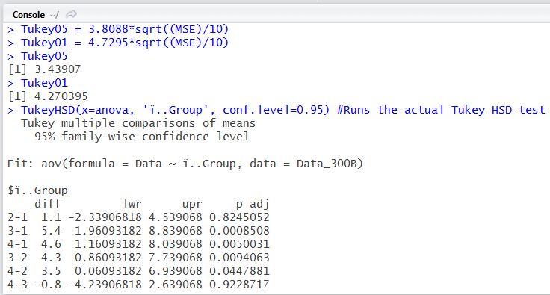
Tukey Output
Below is the Tukey’s output. You will want the critical values for reporting – the first value is for .05 the second is for .01
Then we use the diff columns for our difference (the first value “2-1” is the groups compared, while the second “1.1” is the actually value of the difference)
and the p adj is our p value.
Console Output
.05 value
.01 value

Slide 42
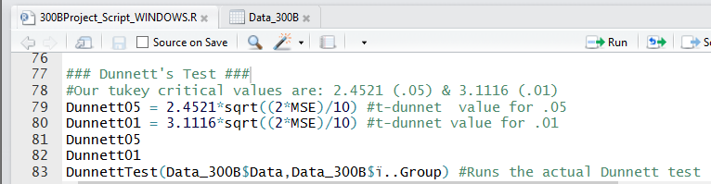
Run Dunnett’s
Below is the lines we need to run for our Dunnett’s test (line 79 to 83)
Output is on the next page
Script Input – Run these lines!

Slide 43
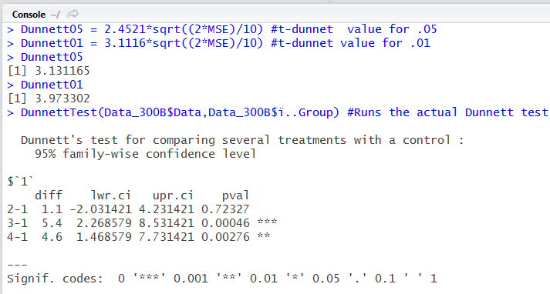
Dunnett’s Output
Below is the Dunnett’s output. You will want the critical values for reporting – the first value is for .05 the second is for .01
Then we use the diff columns for our difference (the first value “2-1” is the groups compared, while the second is the actually value “1.1” of the difference)
and the pval is our p value.
Console Output
.05 value
.01 value

Slide 44
A Note on Planned Comparisons
As of right now, I don’t really see a good way of doing planned comparisons in R
Problem: You will need to run planned comparisons for your project!
Solution: You will need to do it by hand and submit the calculations

Slide 45
Some Extra Slides
The following slides are from Myles Maillet who has some notes on that nature of R and objects in R – you won’t need to worry about them much as I’ve written you a script for ease of use. The next slides are purely to give you perspective/give further info for those interested

Slide 46
Intro to R – Types of Objects
Dataframes: what we will typically work with; can be any number of observations (rows) and at least one predictor/variable (columns)
your_data = read.table(file.choose(new = F), header = T)
Vectors: a string of values; can be numbers, words, etc.
x = c(2, 6, 2, 3, 7, 8, 9)
Values: a single number/character/word/etc.
n_students = 70
*try running the code in red to create these types of objects

Slide 47
Installing packages in R
R is modular, which means there are different packages you can add that offer different functions
One of the packages we will use often is the “psych” package
To install a package:
install.packages(“psych”)
Then, to use a package you have installed:
library(psych)

Slide 48
Functions
Packages have different functions, which is what makes R useful
For example, there are functions to calculate means, standard deviations, variance, and other descriptive statistics
Of course, there are also functions to compute inferential statistics like t-tests and ANOVAs
Functions always have brackets immediately following the function
mean(x)
sd(x)
describe(x) ← this one is in the “psych” package

Slide 49
Tips & Tricks
Always write your code in scripts and save it afterwards. This will allow you to go back and re-run it, and not have to re-write it. Scripts are files that end in “.R”
For each “project”, create a specific folder for that project where you save your data and script. R can read different types of data files, but .csv files work best.
R Studio has a working directory when you are using it (which you don’t see). To make the working directory be your project folder, simply load R Studio by opening the script in that folder
The function “read.table(file.choose(new = F), header = T)” will let you load a .csv by finding it on your computer and loading it. This makes things a bit easier.

Slide 50
Some Useful Functions
For each of these functions, x is the name of your variable (and y is a second variable). If your data is a vector, you can simply type the name of your variable into the functions. If your data is in a dataframe, you need to type the name of the dataframe, then “$”, then the name of your variable
E.g., my_data$gender
Descriptive Statistics:
describe(x)
cor(x, y)
Inferential Statistics:
t.test(x, y)
Graphing:
hist(x)
You can also add addition arguments such as:
“paired=T” for a related samples t-test
“alternative = ___” to specify directional and non-directional tests (“two.sided”, “less”, “greater”)
you can tell R to assume equal variances by adding “var.equal=T”

